Slide 1
Cell Membrane
Year 11 Human Biology
ATAR
PowerPoint #3

Slide 2
SCSA Syllabus Reference
The cell membrane separates the cell from its surroundings with a structure, described by the fluid mosaic model, which allows for the movement of materials into and out of the cell by diffusion, facilitated diffusion, osmosis, active transport and vesicular transport (endocytosis/exocytosis)

Slide 3
Lesson Intention
To explore the structure and function of the cell membrane
To describe how transport occurs across the cell membrane

Slide 4
Success Criteria
describe the structure of the cell membrane
describe the functions of the cell membrane
distinguish between hydrophilic (head) and hydrophobic (tail) parts in a phospholipid molecule
draw a labelled diagram of the cell membrane showing the phospholipid bilayer, channel proteins, carrier proteins and cell- identity markers.
describe the process of passive transport
describe the process of active transport
describe the process of diffusion
describe the process of osmosis

Slide 5
Vocabulary
Homeostasis: the maintenance of a relatively constant internal environment despite fluctuations in the external environment.
Fluid mosaic model: the currently accepted model of cell membrane structure.
Phospholipid: a lipid molecule that contains a phosphate group
Hydrophilic: water loving
Hydrophobic: water hating

Slide 6
Vocabulary
Channel proteins: a protein that allows ions, water and small molecules to pass through the cell membrane.
Carrier proteins: a protein that carries substances from one side of the cell membrane to the other.
Cell-identity markers: help identify and classify cells.
Differentially permeable membrane: membrane that permits the passage of certain substances (usually small molecules) but restricts the passage of others (large molecules); also called a semipermeable, partially permeable or selectively permeable membrane.

Slide 7
Vocabulary
Passive transport: the transport of substances across a cell membrane without the input of energy
Active transport: the use of energy to move substances, usually ions, across a cell membrane against the concentration gradient.
Diffusion: the movement of particles of a fluid so that they are distributed evenly over the available pace; usually taken to mean the net movement of ions or molecules from a higher to a lower concentration until they are evenly distributed.
Osmosis: the movement of water molecules from high to low concentrated areas.

Slide 8
Homeostasis
Body systems work together to ensure that the cellular environment remains stable/kept constant.
This is called homeostasis.
The cells are maintained at a constant temperature, surrounded by fluids with a constant concentration.
To carry out their function cell need to take in and remove certain substances.

Slide 9
Structure of the Cell Membrane
The details of the cell membrane are too small to be seen, even with an electron microscope.
Models have been proposed to account for the behaviour and composition of the cell membrane.
The currently accepted model for cell membrane structure is called the fluid mosaic model.

Slide 10
Structure of the Cell Membrane
The main structure of the membrane is composed of phospholipid molecules, which are lipid molecules containing a phosphate group.
The phospholipids are arranged in two layers (bilayer)
Each phospholipid molecule has a head that is hydrophilic (water-loving) and a tail that is hydrophobic (water-hating).

Slide 11
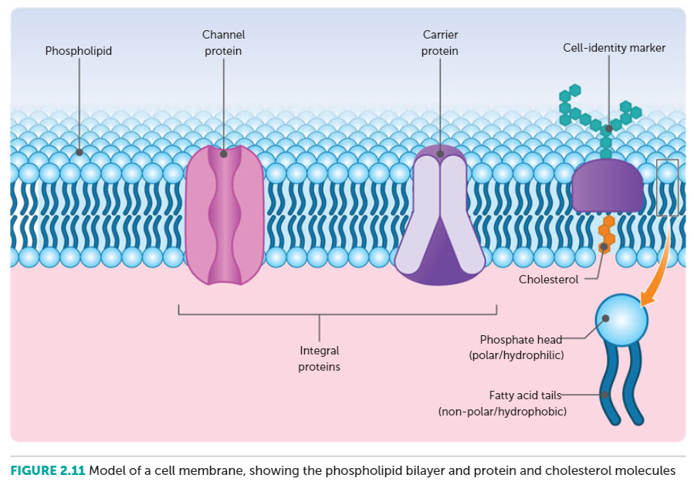
Draw this ☺

Slide 12
Structure of the Cell Membrane
The phospholipids are arranged in two layers with their heads on the outside and tails on the inside.
Embedded in the phospholipid bilayer are cholesterol and protein molecules. These molecules are important for the function integrity and stability of the membrane.
Cell membranes have a variety of protein molecules, including receptor proteins, channel proteins, carrier proteins and cell identity markers.

Slide 13
Function of the Cell Membrane
The cell membrane has 4 main functions
It acts as a physical barrier between the inside and outside of the cell
It regulates the passage of materials
It is sensitive to changes e.g. receptors detect environmental changes
It helps support the cell e.g. the internal part of the cell membrane is attached to the cytoskeleton.

Slide 14
Passive vs Active
Passive processes DO NOT use energy
Active processes USE the cell’s energy in the form of adenosine triphosphate (ATP).

Slide 15
Simple Diffusion
Diffusion results in the movement of particles until they are evenly distributed over the space available.
It occurs in fluids.
Particles move from a higher concentration to a lower concentration until they are evenly distributed.
E.g. oxygen, carbon dioxide, alcohol, steroids and other fat soluble substances move via diffusion

Slide 16
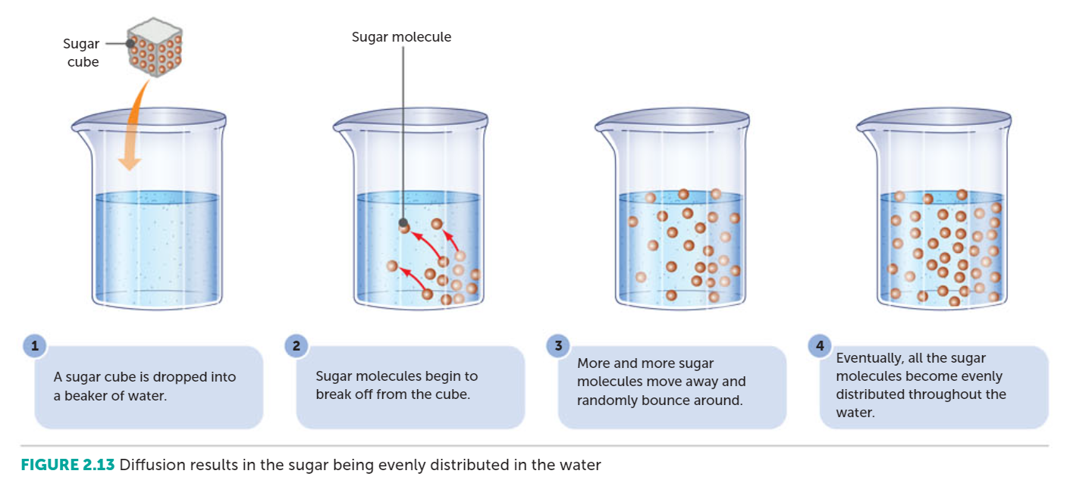

Slide 17
Osmosis
It is the diffusion of a solvent through a differentially permeable membrane in order to balance the concentration of another substance.
E.g. water
The higher level on one side of the membrane results from a pressure, known as osmotic pressure. The higher the concentration of the solute, the higher the osmotic pressure.

Slide 18
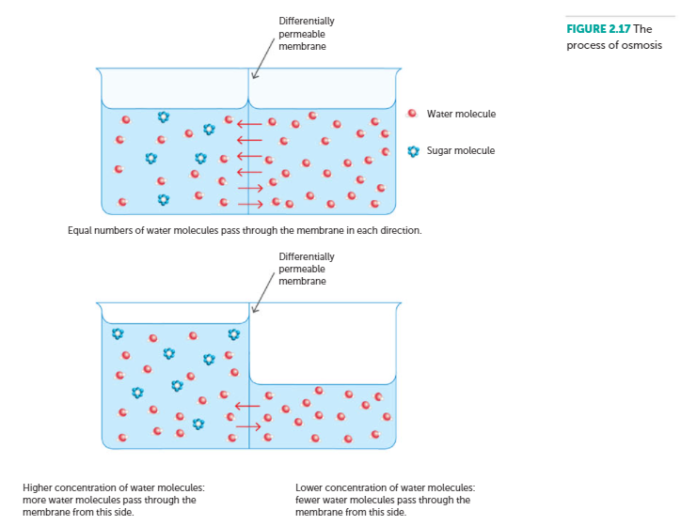

Slide 19
Recall Knowledge
Using a labelled diagram, describe the process of diffusion
Explain the relevance of a concentration gradient

Slide 20
Apply Knowledge
Explain why a cell will expand when placed in a solution of a low concentration of a solute.

Slide 21
Homework
Cells need to take in many substances to function correctly.
List five substances that a cell needs to take in.
Briefly state why each of those substances are important for the cell.

Slide 22
Reading
Pages 34- 37 (top half) : Transport across the Cell Membrane

